Slide 1
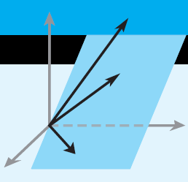
Elementary Linear Algebra
Chapter 5
Notes:
*

Slide 2
Chapter 5
Eigenvalues and Eigenvectors
5.1 Eigenvalues and Eigenvectors
5.2 Diagonalization
5.3 Complex Vector Spaces
Notes:
*

Slide 3
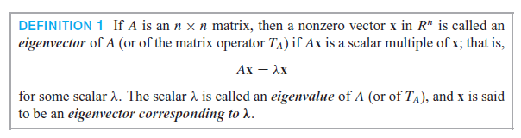
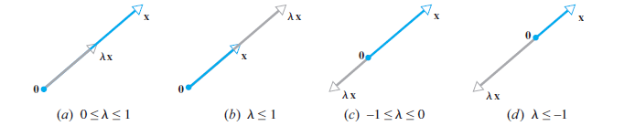
Section 5.1
Eigenvalues and Eigenvectors
Notes:
*

Slide 4
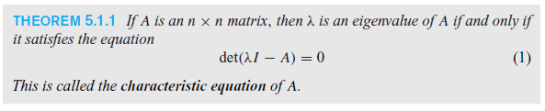
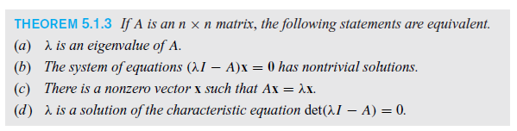
The Characteristic Equation
Notes:
*

Slide 5
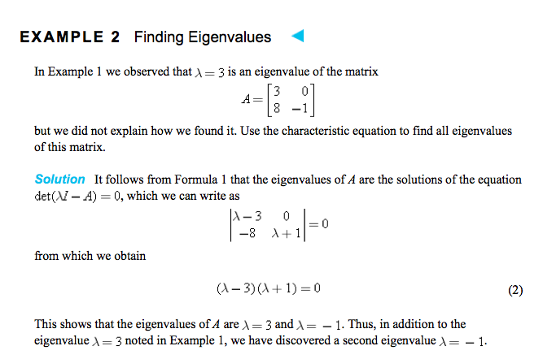

Slide 6
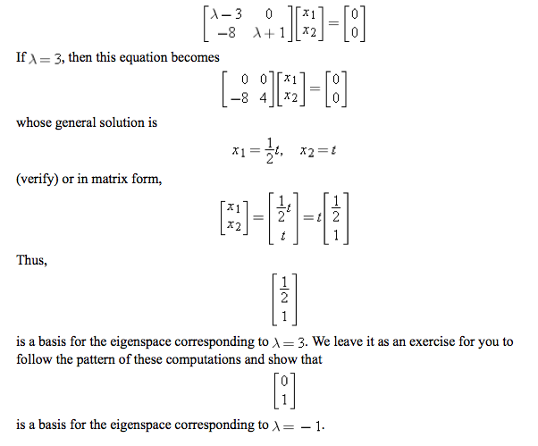

Slide 7
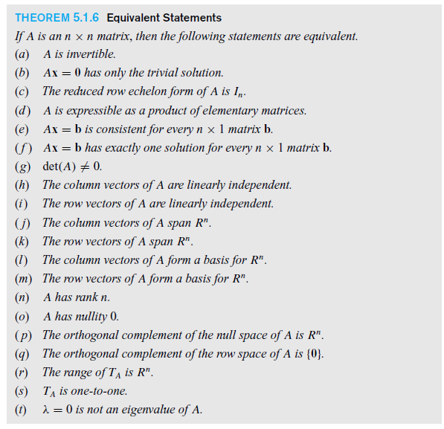
Notes:
*

Slide 8


Section 5.2 Diagonalization
Notes:
*

Slide 9
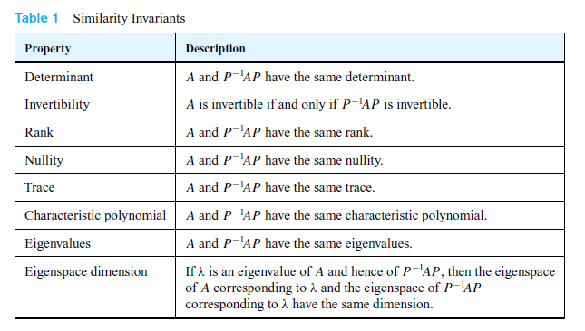
Similarity Invariants
Notes:
*

Slide 10
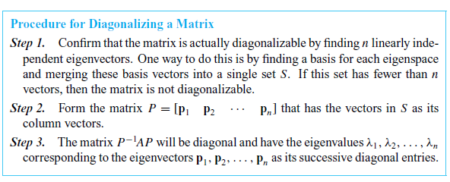
Diagonalizing a Matrix
Notes:
*

Slide 11
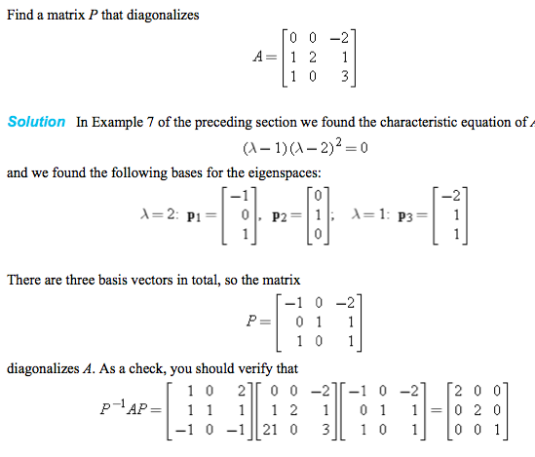

Slide 12
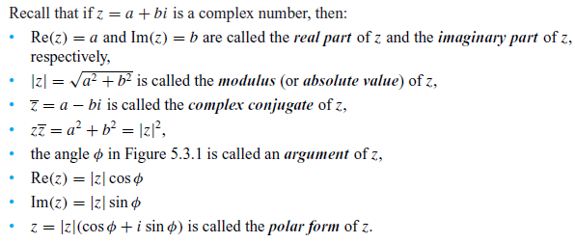
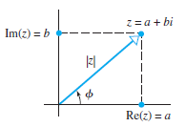
Section 5.3 Complex Vector Spaces
Notes:
*

Slide 13
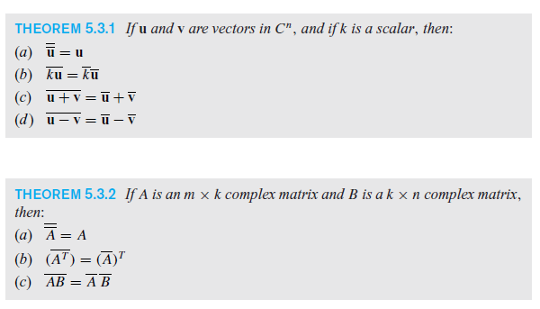
Algebraic Properties of the Complex Conjugate
Notes:
*

Slide 14
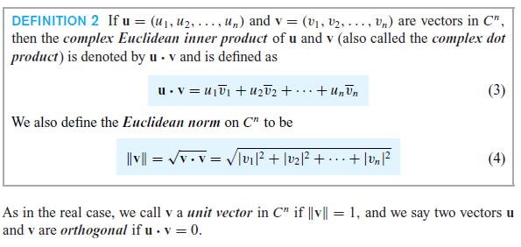
Dot Product and Norm
Notes:
*

Slide 15
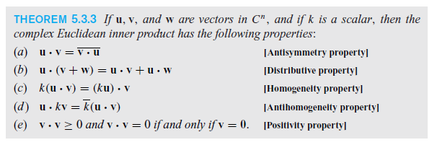
Properties of the Dot Product
Notes:
*

